Slide 1
Impact of working from home during COVID-19
Ayşegül GÖKTAŞ
17030411037

Slide 2
INTRODUCTION
Rapid increase in the rate of working from home with the COVID-19. COVID-19 has affected day to day life and is slowing down the global economy.
This pandemic has affected thousands of peoples, who are working in somewhere to continue their life.
Many areas, sectors and occupations have been caught unprepared for this situation and they have suffered unforeseen losses.
Also, some of them decided on home-work programs due to the spread of the epidemic disease.

Slide 3
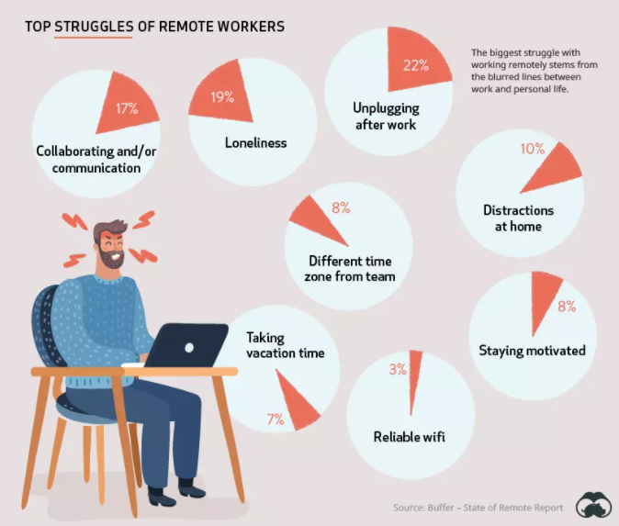
While working at home has positive effects on employees, it also has many negative effects. However, the rate of working at home is constantly increasing due to COVID-19.

Slide 4
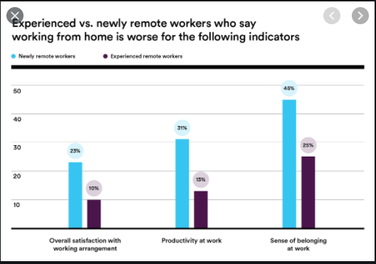

Slide 5
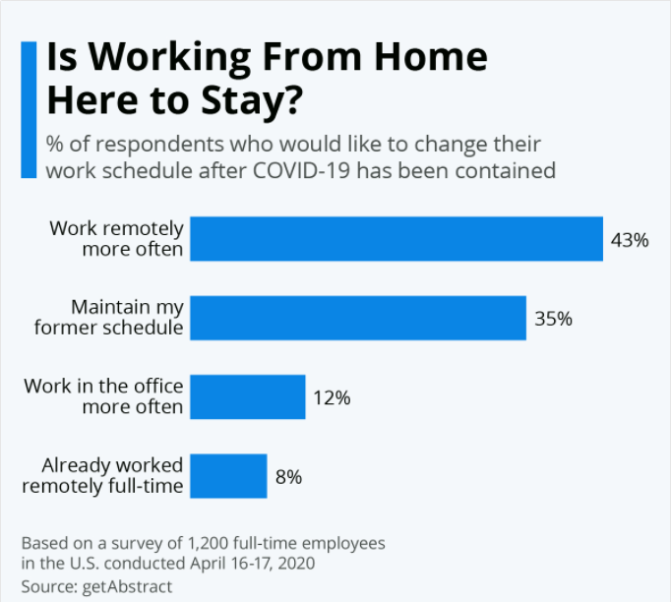
There are downsides to working from home as well though, as the survey results confirm. 27 percent of the respondents state they’d feel isolated if they continued working from home after the pandemic, while 20 percent cite technological flaws as a drawback and 19 percent fear becoming detached from their company and colleagues

Slide 6
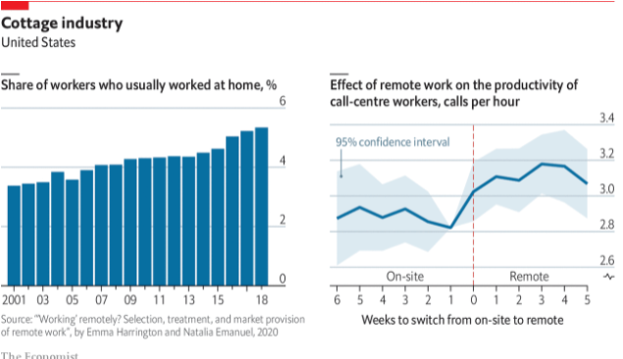

Slide 7
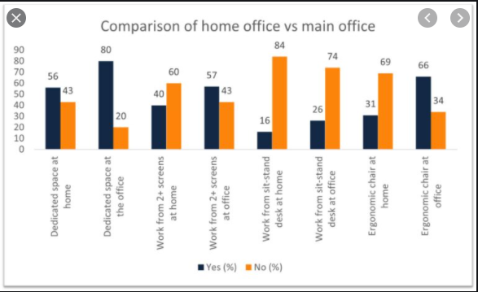

Slide 8
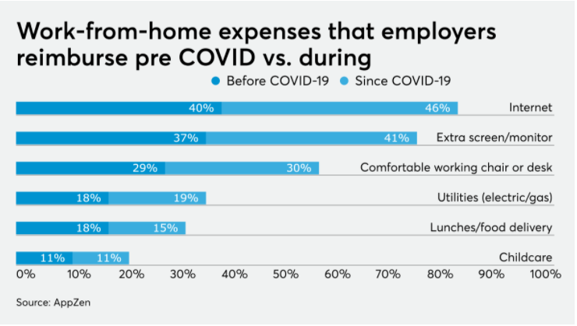

Slide 9
RESULT
COVID-19 affected industries negatively and positively. While some sectors and their methods grew rapidly with the help of pandemic conditions, others faced serious problems. One of them is the method of working at home.

